Slide 1
Assistive Technology
Sara Muharemovic

Slide 2

If your face is like this, FEAR NOT!

Slide 3
Well what is it?
Assistive Technology is an umbrella term that includes assistive, adaptive, and rehabilitative devices for people with disabilities and also includes the process used in selecting, locating, and using them. AT promotes greater independence by enabling people to perform tasks that they were formerly unable to accomplish, or had great difficulty accomplishing, by providing enhancements to, or changing methods of interacting with, the technology needed to accomplish such tasks.

Slide 4

GUESSING GAME

Slide 5
Let’s take another look

Slide 6


Was your guess correct?

Slide 7
Assistive technology includes many specialized devices as well, like typing telephones for people who are deaf and motorized wheelchairs for people who cannot walk. Assistive technology can be "low-tech" (something very simple and low-cost, like a pencil grip), or "high-tech" (something sophisticated, like a computer). Assistive technology can be critical for the person using it - if you wear glasses, think how hard it would be to get through the day without them.

Slide 8
Glasses!
Around 1000AD, the first vision aid was invented (inventor unknown) called a reading stone, which was a glass sphere that was laid on top of the material to be read that to magnified the letters.
Around 1284 in Italy, Salvino D'Armate is credited with inventing the first wearable eye glasses.

Slide 9
Assistive Technologies
People with disabilities meet barriers of all types. However, technology is helping to lower many of these barriers. By using computing technology for tasks such as reading and writing documents, communicating with others, and searching for information on the Internet, students and employees with disabilities are capable of handling a wider range of activities independently. Still, people with disabilities face a variety of barriers.

Slide 10
Latest forms of technology

Slide 11
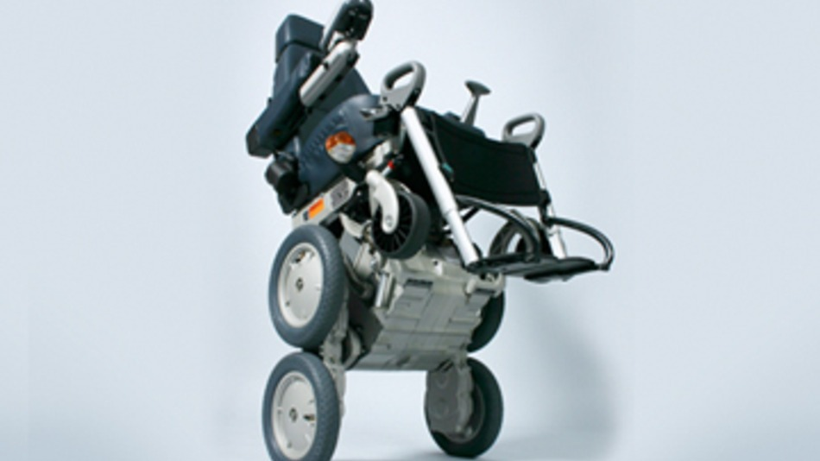
The iBot Stair-Climbing Wheelchair
From the mind of Dean Kamen, the iBot is a self-balancing, stair-climbing wheelchair for the physically disabled. Stairs are nearly everywhere, and navigating them in a traditional wheelchair is impossible. Enlisting the services of others to drag or carry you and your chair up those stairs is dangerous, inconvenient and often embarrassing. Using self-balancing technology similar to that found in the Segway, the iBot aims to change this by giving wheelchair-bound individuals the freedom to navigate any terrain. In short, this is the ATV of wheelchairs.

Slide 12
The DEKA Robotic Arm
Segway inventor Dean Kamen and his group of researchers didn't stop at their stair-climbing wheelchair. Funded on a grant from the Department of Defense's DARPA research agency, Kamen and his team were tasked with the job of creating a highly sophisticated, highly functional prosthetic arm for injured soldiers returning from the Middle East.
The results are amazing — a less-than-eight-pound prosthetic arm with such precision and control that it can peel a grape. The arm supports a number of customizable controls and modular components, making it easy to tailor to the wearer's individual needs, whether he requires only a hand or an entire arm and shoulder socket.
Another promising feature of the arm is its sensory feedback system. Hand sensors measure the strength of the hand grip, for instance, and provide feedback to the wearer in the form of vibrations that grow stronger as the strength of the grip increases. This enables the wearer to learn what level of grip strength is and isn't appropriate for specific tasks, and how much pressure is being applied.
https://www.youtube.com/watch?v=R0_mLumx-6Y

Slide 13
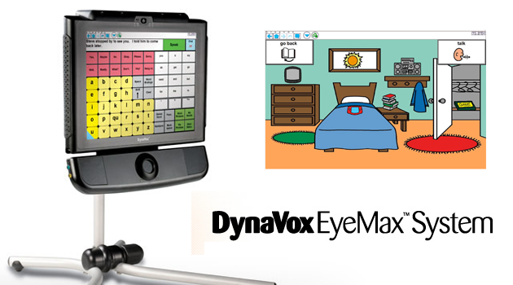
The DynaVox EyeMax System
In combination with the Vmax+, the DynaVox EyeMax system gives individuals with paralysis, cerebral palsy and stroke victims the ability to participate in spoken communication using only their eyes. Using a sophisticated eye tracking system, users can interact with an on-screen keyboard, allowing them to enter words and phrases, which are then translated into spoken text via the device's text-to-speech mechanism.
In addition to the on-screen keyboard, the InterACCt language software on the device offers hundreds of pre-defined phrases and words, which can be selected from lists or chosen via pictures and scenes, making the device instantly accessible to young children and the mentally disabled who may be unable to grasp written language.

Slide 14
Cochlear Implant
More than just a hearing aid, the cochlear implant first picks up sound via a microphone, which then carries the signal to a small computer worn behind the ear, where it is transferred to a digital signal and transmitted to the implant, itself. Once received by the implant, the device then directly stimulates the auditory nerve, providing an entirely new means of auditory sensory input.
Development on the cochlear implant first began in the late 1950s, and the first commercial implant device received FDA approval in 1984. However, cochlear implants have come a long way since those early days. Initially, the single-channel implant provided mostly static, while early commercial implants with five channels allowed for some indication of cadence and rhythm. Today's cochlear implants, however, have more than twenty sound channels, allowing wearers to hear with much better quality. The implant is still far from perfect, with background noise continually being a problem, but the technology has advanced to such a point now that voices can be heard with enough clarity to be readily understood and identified, making verbal communication possible and productive.
https://www.youtube.com/watch?v=SmNpP2fr57A

Slide 15
Driverless car
Not only could this car serve as a means of independent, safe transportation for the visually impaired, but also for any number of individuals with physical and mental handicaps that prevent them from operating a motor vehicle.
Led by Sebastian Thrun, director of the Stanford Artificial Intelligence Laboratory and co-inventor of Google Street View, the team of engineers at Google has created a vehicle which operates on a combination of information from Google Street View, artificial intelligence surrounding information gathered by numerous sensors and cameras mounted on the vehicle to drive itself.
https://www.youtube.com/watch?v=bp9KBrH8H04

